Slide 1

GLOBAL SUPERSTORE PROFIT ANALYSIS REPORT
NAME: BHAGYA P BIJAY KUMAR
COLLEGE: AMITY UNIVERSITY MUMBAI,MAHARASHTRA
COURSE: BCA
Student ID: STU666d5b2cab0ac1718442796

Slide 2

PROBLEM STATEMENT
In the competitive retail industry, staying ahead requires a deep understanding of sales performance, customer behavior, and inventory management. These elements are crucial for making informed decisions that can drive growth, enhance customer satisfaction, and improve operational efficiency.
The Global Superstore dataset provides comprehensive data on sales, profits, customer demographics, and product categories, offering a wealth of information that can be harnessed to gain valuable insights. However, extracting meaningful insights from this extensive dataset can be challenging due to its complexity and volume. The data must be carefully cleaned and prepared to ensure accuracy and completeness.
Advanced analytical techniques are required to uncover patterns, trends, and relationships within the data. Despite these challenges, a thorough analysis of the Global Superstore dataset can reveal critical insights that drive better decision-making, optimize operations, and ultimately enhance profitability.

Slide 3
Project Description
The objective of this project is to address these problems by thoroughly analyzing the Global Superstore dataset using Power BI. By leveraging Power BI's powerful visualization and analytics capabilities, the comprehensive analysis will help identify key patterns and trends within the dataset.
The primary objectives are to optimize operations, enhance customer satisfaction, and increase profitability. By examining various aspects of sales performance, customer behavior, and inventory management, we can pinpoint areas for improvement and make data-driven decisions that positively impact the business.
Through this analysis, we aim to empower the Global Superstore to make informed decisions that drive better business performance. The insights gained from this project will enable the company to strategically adjust its operations, tailor its marketing strategies, and ultimately boost its overall profitability.

Slide 4

WHO ARE THE END USERS?
Senior Management: CEOs, CFOs, and VPs would be interested in the overall profitability of the company, trends across regions and product categories, and how profit compares to industry benchmarks.
Sales Managers and Marketing Directors: Sales managers and marketing directors would use the report to identify high-profit product lines, customer segments, and geographic markets. This helps them focus their efforts on areas with the greatest potential return.
Product Managers: Product managers and buyers would use the report to understand which products contribute the most profit and which ones have low margins that need improvement. They might also use it to identify opportunities for new product lines or pricing adjustments.
Financial Analyst: Financial analysts and accountants would be interested in the details behind the profit figures, such as cost breakdowns, pricing strategies, and tax implications.
Operations Managers: Operations managers might use the report to identify areas for cost reduction, such as optimizing logistics or negotiating better deals with suppliers.

Slide 5

Technology Used
Microsoft Power BI:
ETL (Extract, Transform, Load) Tools:
Power Query Editor.
Visualization: Bar charts, line charts, pie charts, maps, etc.
Slicers: Interactive elements that let users filter data by clicking or selecting options.
Power BI Service.

Slide 6
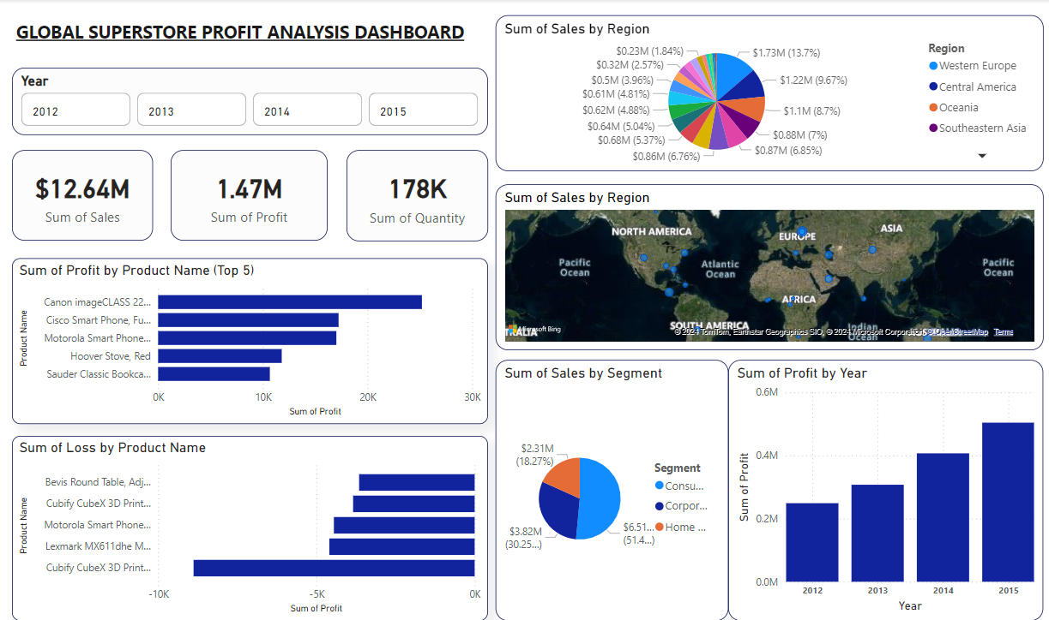
RESULTS: GLOBAL SUPERSTORE PROFIT ANALYSIS REPORT

Slide 7
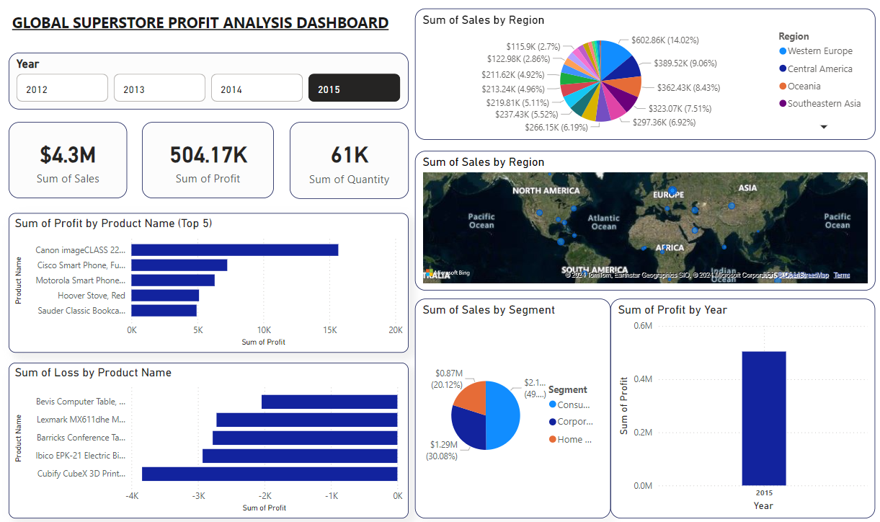
RESULTS: GLOBAL SUPERSTORE PROFIT ANALYSIS REPORT

Slide 8
LINK:
Power Bi Report
Dataset

Slide 9
Thank you

